Slide 1
Diabetes & Covid19
Reihaneh Mohsenipour
Pediatric Endocrinologist
Children,s Medical Center , Tehran University of Medical Sciences

Slide 2
Case presentation

Slide 3
Case 1
A 16/5 yrs old boy admitted to hospital by loss of consciousness , acidotic respiration , miosis (Not responding to naloxan), polyuria , polydipsia
CBC :NL
HBA1C :12.2 , Anti GAD ab : posetive
BS : 645
LFT : NL
TSH :0.3 FT4 : 0.5 ACTH : 18 Cortisol : 26
TG & chol : NL
Urine ketone: negative
Covid PCR : positive

Slide 4
PH | 6.9 | 6.7 | 7.05 | 7.11 | 7.18 | 7.19 | 7.20 | 7.28 | 7.30 | 7.32 | 7.36 | 7.4
HCO3 | 6.7 | 8 | 9.4 | 5.4 | 7.3 | 8.4 | 10.1 | 12 | 14.5 | 16 | 16.3 | 18
BUN | 26 | 34 | 36 | 40 | 54 | 63 | 65 | 30 | 11 | 12 | 22
Cr | 1.9 | 2 | 2.7 | 2.8 | 3 | 2.9 | 2.9 | 2.3 | 1.5 | 1.3 | 0.8
Na | 156 | 149 | 159 | 157 | 166 | 167 | 170 | 165 | 159 | 153 | 164 | 159 | 154 | 149 | 142
K | 3.6 | 3.7 | 4 | 4 | 4.1
Ca | 9.4 | 9.5 | 8.9 | 6.6 | 7.9 | 8 | 8.4 | 7.9 | 8.5 | 9
P | 0.6 | 1 | 0.8 | 0.4 | 1.8 | 1.5 | 4.6 | 3.1 | 2.9 | 3.1
Mg | 2.5 | 1.2 | 1.5 | 2.1 | 1.8 | 1.7

Slide 5
In his admission , follow up echocardiography showed coronary ectasia( LAD )
D dimer Troponin CPK Ferritin
Patient treated with IVIG and corticosteroid(MISC )
Paresthesia of left lower limb L3 – L4 discopathy with pressure effect on nerve root

Slide 6
Case 2
A 13 yrs old girl admitted to hospital by recurrent vomiting , GI bleeding , loss of consciousness , sudden loss of vision , polyuria , polydipsia , weight loss , Covid case index +
Severe dehydration
First GCS : 9-10
WBC:25.9(N 71% , L 12% ) HB : 13.3 PLT : 319000
VBG : PH : 6.8 , HCO3 : 2.2 , PCO2 : 8
BS : 910
Urine ketone: NEG
Covid PCR : NEG
TSH : 1.7 , FT4 : 1
Vit D : 3
HBA1C : 15.4
PT : 17.5 , INR : 1.3 , PTT : 30
Lactate : 68

Slide 8
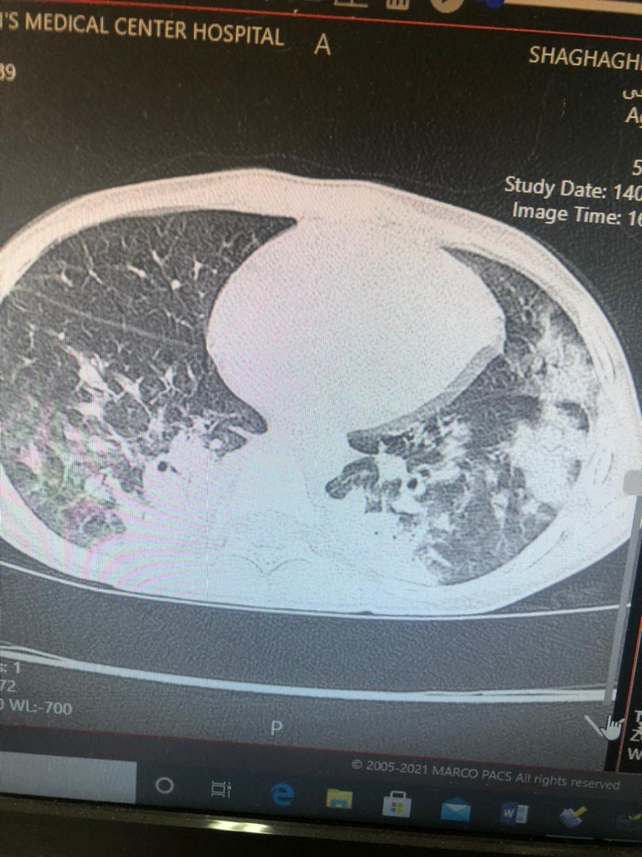

Slide 9
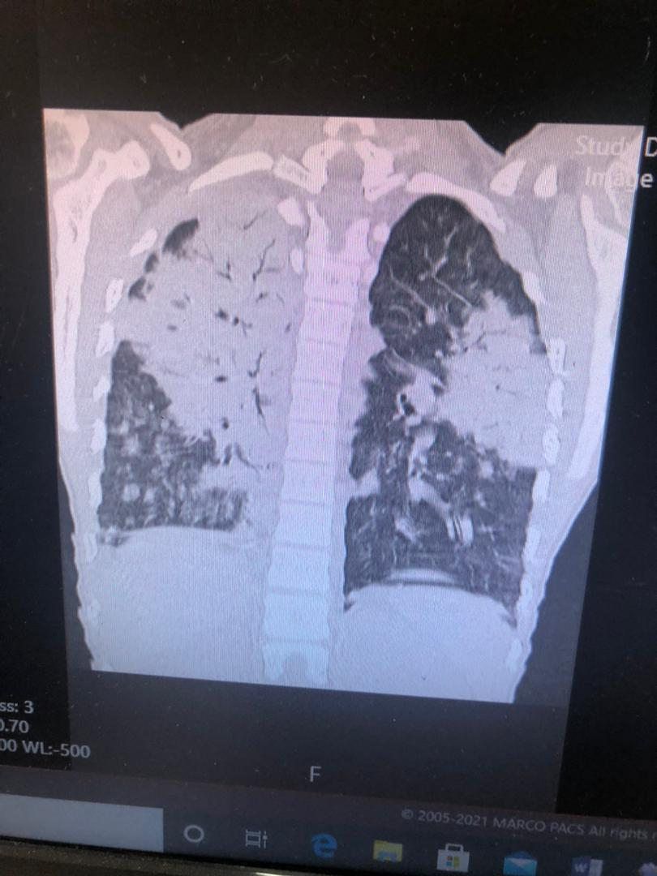

Slide 10
BUN | 8 | 23 | 45 | 60 | 52 | 49 | 29 | 20
Cr | 1 | 1.8 | 2.4 | 3.4 | 1.9 | 1.8 | 1.1 | 0.9
Na | 141 | 140 | 149 | 146 | 145
K | 2.8 | 3 | 3.1 | 3.2 | 3.5 | 4.1
Ca | 6.5 | 7 | 8 | 11 | 8.3 | 8.7
P | 4.1 | 0.5 | 2.2 | 3
Mg | 2.3 | 2

Slide 11
At first because of weak peripheral pulse , neurologic finding , poor respiratory situation , She intubated and received mannitol and bicarbonate
In her admission time , she received bicarbonate again ( tachycardia, PH<7.1)
Low BP Epinephrin & Dopamin drip
BAL : candida
Evaluating immunodeficiency was NL

Slide 12
D dimer Fibrinogen Ferritin
MISC IVIG , CORTICOSTEROID pulse

Slide 13
Case 3
A 13 months old boy admitted to hospital by acidosis , high BS , urine ketone
HBA1C : 5.6

Slide 14
There was no increase in incidence of DM1 in children during the pandemic; however, there was a significant increase in rates of DKA
There was a significant increase in DKA and severe DKA in children presenting with new onset DM1 during the COVID-19 pandemic period. This emphasizes the need for educating health care professionals and families to be aware of the symptoms of hyperglycemia and the importance of early diagnosis and treatment even during public health measures for COVID-19.
Some studies found a statistically significant increase in diabetic ketoacidosis and severe ketoacidosis in children and adolescents presenting with new-onset T1DM. A probable explanation is that this finding reflects patients trying to delay hospital admission because of their fear of acquiring SARS-CoV-2 infection

Slide 15
In contrast to adults, diabetes does not appear to predispose children with T1D to COVID-19 infection
as with all infections, COVID-19 may lead to glycemic dysregulation

Slide 16
COVID-19 and Pre-existing Diabetes
Although , pre-existing diabetes did not increase the risk of occurrence of COVID-19 but in some areas the rate of DKA is increased.
There was a significant increase in :
severity and complication of COVID-19
risk of hospitalization
requirement for emergency care
exaggerated inflammatory response
require mechanical ventilation and ICU support
markedly higher risk of mortality

Slide 17
Pathogenesis
. Angiotensin-converting enzyme 2 (ACE2), which is part of the renin–angiotensin–aldosterone system (RAAS), is the main entry receptor for SARS-CoV-2

Slide 18
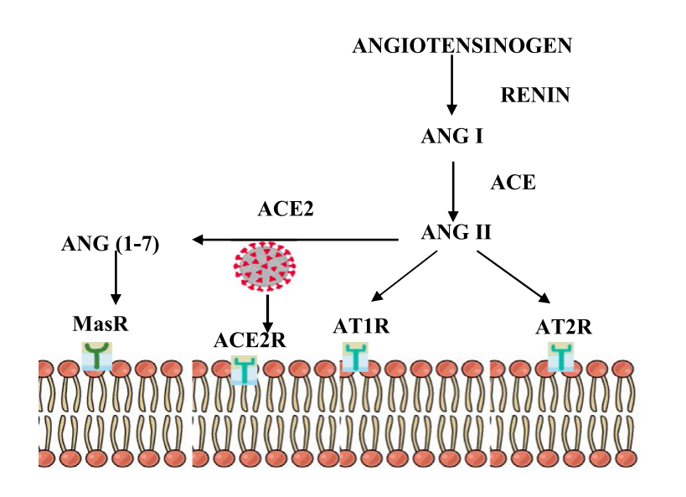

Slide 19
The angiotensin converting enzyme 2 (ACE2) receptor is the binding site for SARS-CoV-1 and and is strongly expressed in pancreatic endocrine cells Previous evidence suggests that SARS-CoV-1 virus may have entered pancreatic islet cells via the ACE2 receptor leading to b-cell damage and new-onset, mainly transient diabetes

Slide 20
Angiotensin II signalling occurs via AngII receptor type 1 (AT1R) and receptor type 2 (AT2R).
The activation of AT1R exerts proinflammatory , proliferative, profibrotic and vasoconstrictive effects via the activation of NF-k, NADH/NADPH oxidase and toll-like receptor 4
Connecting between virus and ACE2R causes downregulation and therefore increasing in AG2 that causes inflammatory responses through IL 1 , IL 6 , IL 10 , IFN gamma secretion increasing inflammatory responses and hypercoagulation endothelial damage hypoxia

Slide 21
Viral binding to ACE2 receptors downregulate their expression on the alveolar epithelial cells and results in elevated Ang II expression

Slide 22
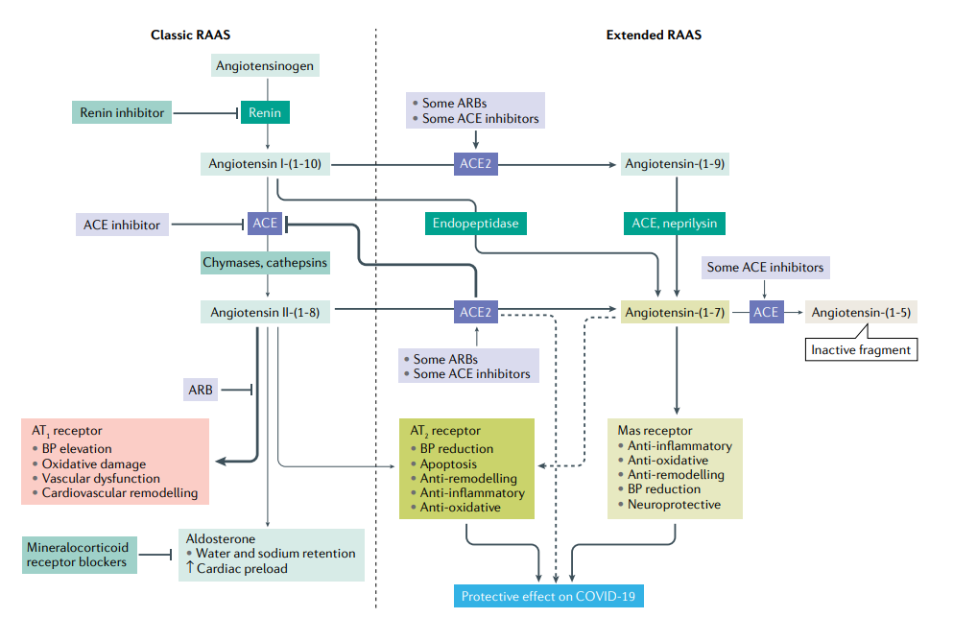

Slide 23
In adults , Patients at high risk of severe COVID-19 or death have several characteristics, including advanced age and male sex, and have underlying health issues, such as cardiovascular disease (CVD), obesity and/or type 1 diabetes mellitus (T1DM) or type 2 diabetes mellitus (T2DM)
In human monocytes, elevated glucose levels directly increase SARS-CoV-2 replication, and glycolysis sustains SARS-CoV-2 replication via the production of mitochondrial reactive oxygen species and activation of hypoxia-inducible factor 1α20. Therefore, hyperglycaemia might support viral proliferation

Slide 24
link between severe COVID-19 and diabetes mellitus is observed.
Several mechanisms are thought to be responsible for an accentuated clinical severity of COVID-19 in people with diabetes mellitus .
Glucotoxicity, endothelial damage by inflammation, oxidative stress and cytokine production contribute to an increased risk of thromboembolic complications and of damage to vital organs in patients with diabetes mellitus. In addition, drugs often used in the clinical care of patients with COVID-19, such as systemic corticosteroids or antiviral agents, might contribute to worsening hyperglycemia

Slide 25
Drugs:
Chloroquine ↑ Insulin sensitivity , ↑ hepatic insulin sensitivity , ↑ β-Cell function
Protease inhibitor(kaletra) ↑ FPG , ↑ BG in patients with new-onset DM , ↓ insulin sensitivity , ↓ glucose clearance , ↓ β-Cell function
RNA polymerase inhibitors(favipravir) ↓ Insulin level( animal study)
IL-6 receptor inhibitors(actemra) ↓ Insulin level ,↓ insulin-to-glucose ratio
Corticosteroids ↑ Insulin resistance , ↓ Insulin production and secretion

Slide 26
It is suggested using mainly insulin for critically ill patients with diabetes mellitus infected with SARS-CoV-2. Optimal glucose control using insulin infusion statistically significantly reduced IL-6 and D-dimer levels and improved severity in patients with COVID-19 with or without diabetes mellitus.
Metformin has shown anti-inflammatory actions in preclinical studies, and furthermore metformin treatment reduced the circulating levels of inflammation biomarkers in people with T2D.

Slide 27
Case reports have described patients with newly diagnosed T1DM with ketoacidosis occurring at the onset of COVID-19 , and patients with newly diagnosed T1DM without ketoacidosis in whom ketoacidosis occurred several weeks after apparent recovery from COVID-19.

Slide 28
ISPAD Clinical Practice Consensus Guideline: Diabetic ketoacidosis in the time of COVID-19 and resource-limited settings-role of subcutaneous insulin
For mild to moderate DKA :
The suggested starting dose of SC rapid-acting insulin analog (lispro or aspart) is 0.15 U/kg, 1 hour after commencement of IV fluid replacement. SC doses should be subsequently administered every 2 hours until resolution of DKA. The dose of SC insulin analog can be reduced to 0.1 U/kg every 2 hours
BG should be monitored every 1 to 2 hours aiming to maintain the level at 11 mmol/L (200 mg/dL) until DKA has resolved.
SC insulin therapy may not be appropriate in severely dehydrated patients.
Evidence is limited for SC insulin as treatment of DKA in infants and very young children (age < 2 yrs ), and hence is not recommended for this group

Slide 29
SC administration of short-acting regular insulin every 4 hours is a safe and effective alternative to IV insulin infusion in children with DKA and pH ≥7.1.
A suggested starting dose is 0.13 to 0.17 U/kg/dose every 4 hours (0.8 to 1 U/kg/day given in divided doses), increased or decreased stepwise by 10% to 20% based on the BG prior to insulin injection. Dosing frequency may be increased to every 2 or 3 hours if acidosis is not improving.
SC rapidacting insulin analogs are rapidly absorbed into the blood and plasma insulin concentrations reach peak values by 60 minutes of administration. The glucose lowering effect reaches a maximum by 90 to 120 minutes after injection
IM insulin may be preferred over SC insulin if there is poor tissue perfusion and IV insulin is not an option.

Slide 30
SC insulin therapy may not be appropriate in youth with severe dehydration, when reduced tissue perfusion (capillary refill time >3 seconds) persists after fluid resuscitation, in young children (age < 2 yrs ) and in children with comorbidity that warrant ICU admission

Slide 31
Thank you for your attention

